Slide 1
Tastey
Cooking Made Convenient
Luke Buchanan
Cade Edwards
Rayven Gsell
Dan Nguyen
Shoham Sanyal
Matthew Singsing

Slide 2
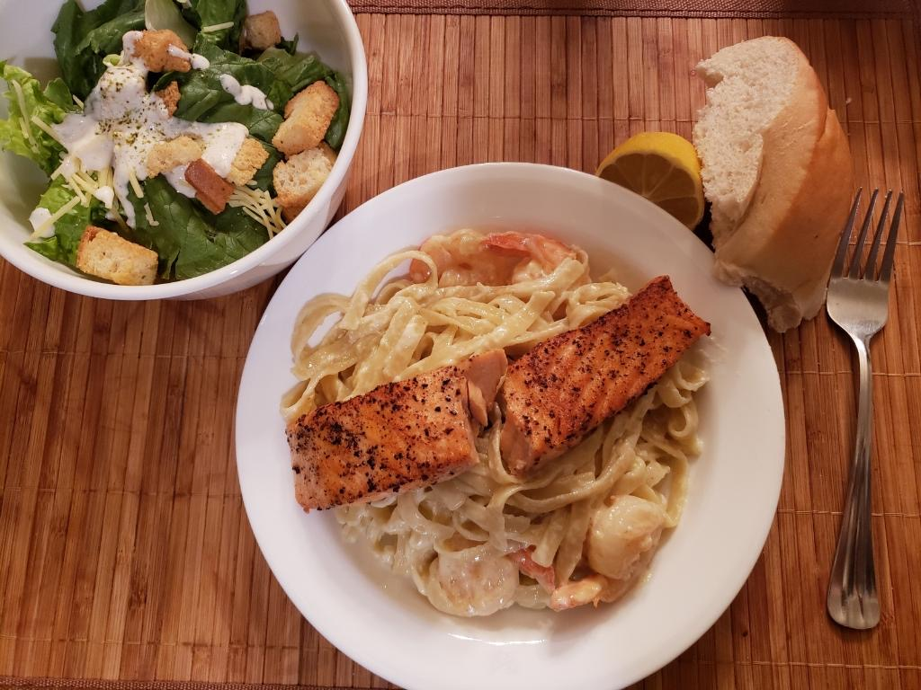
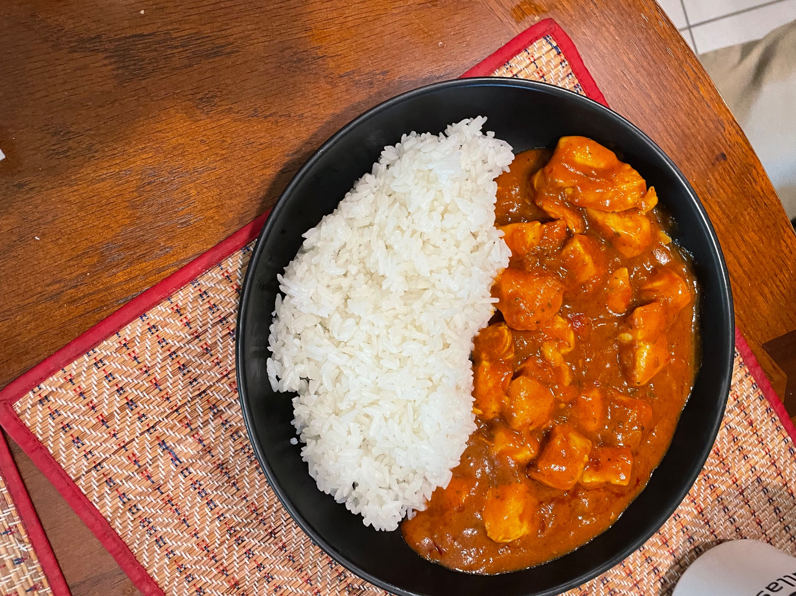
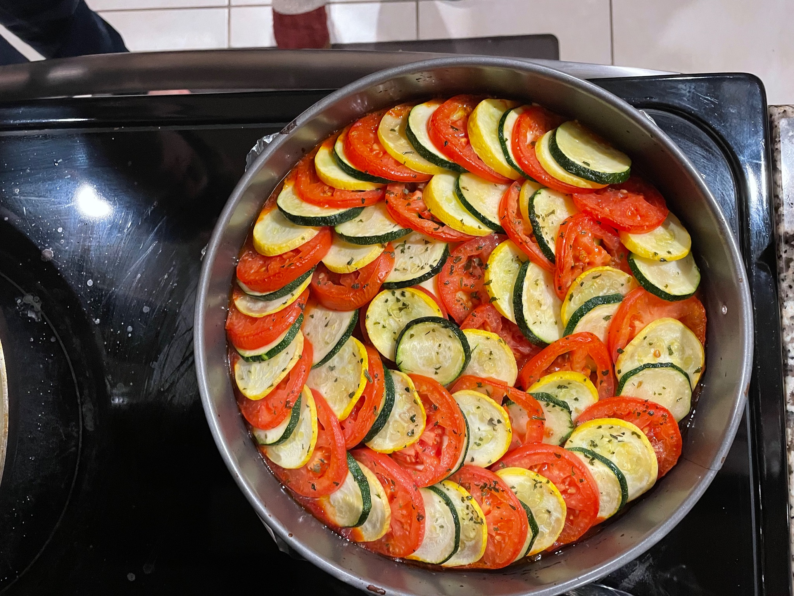
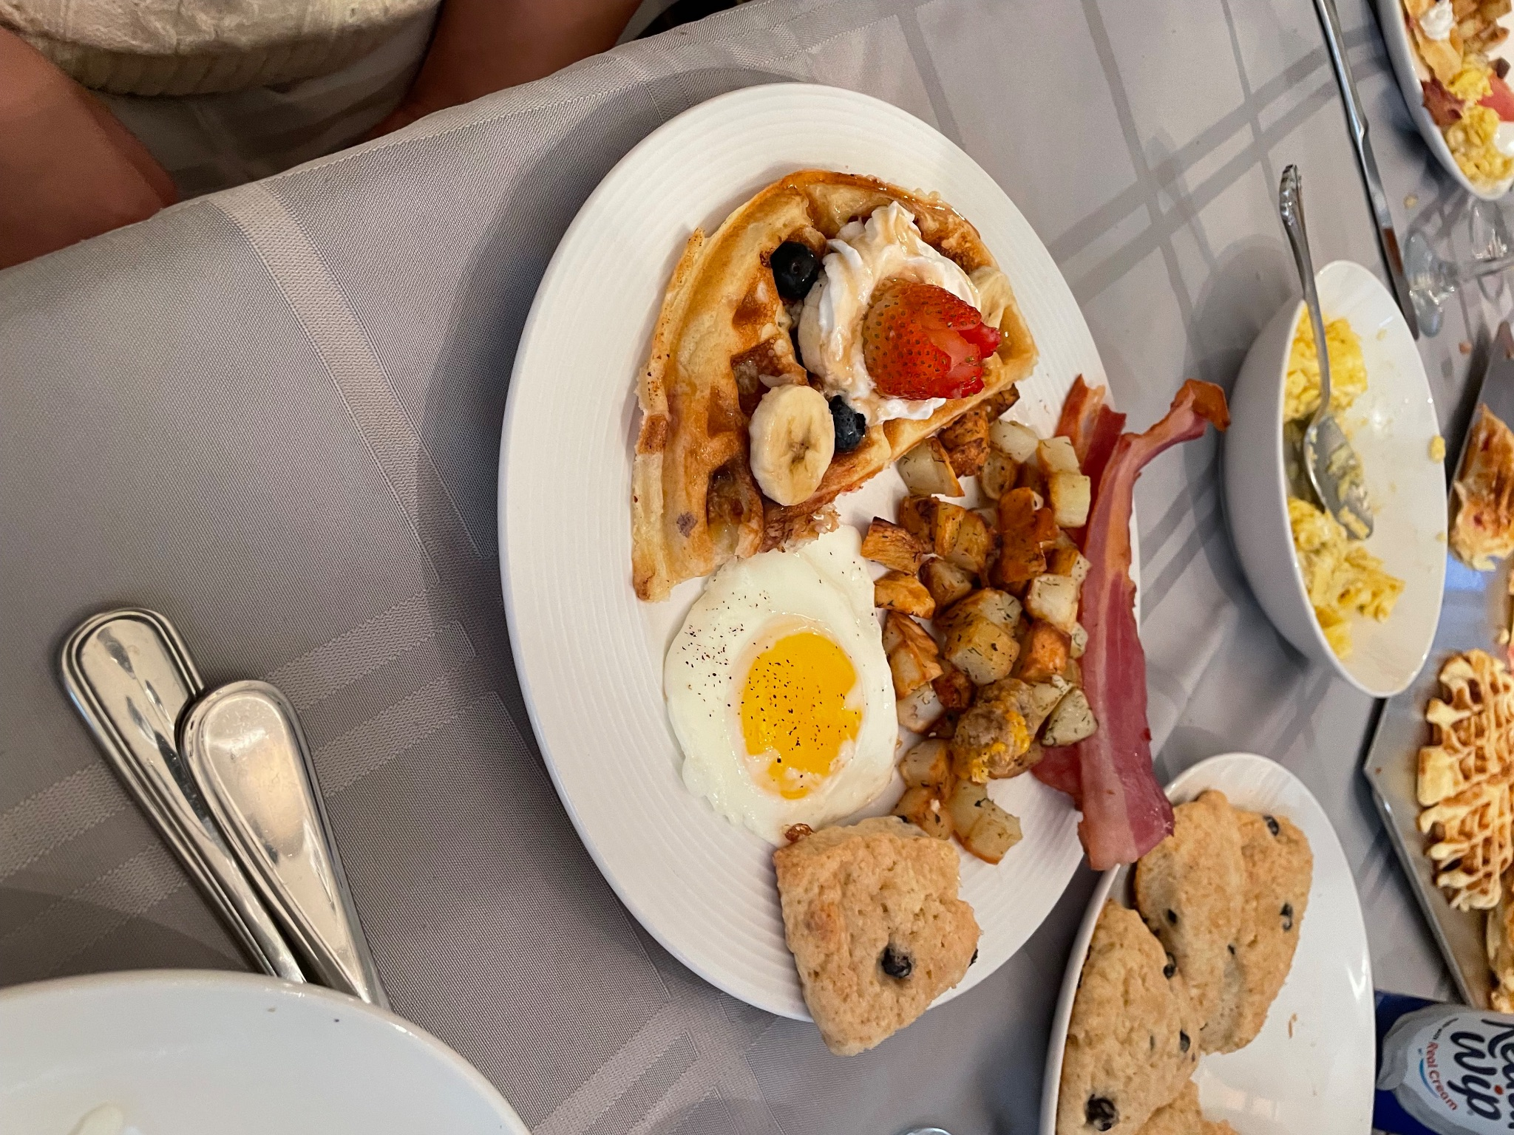
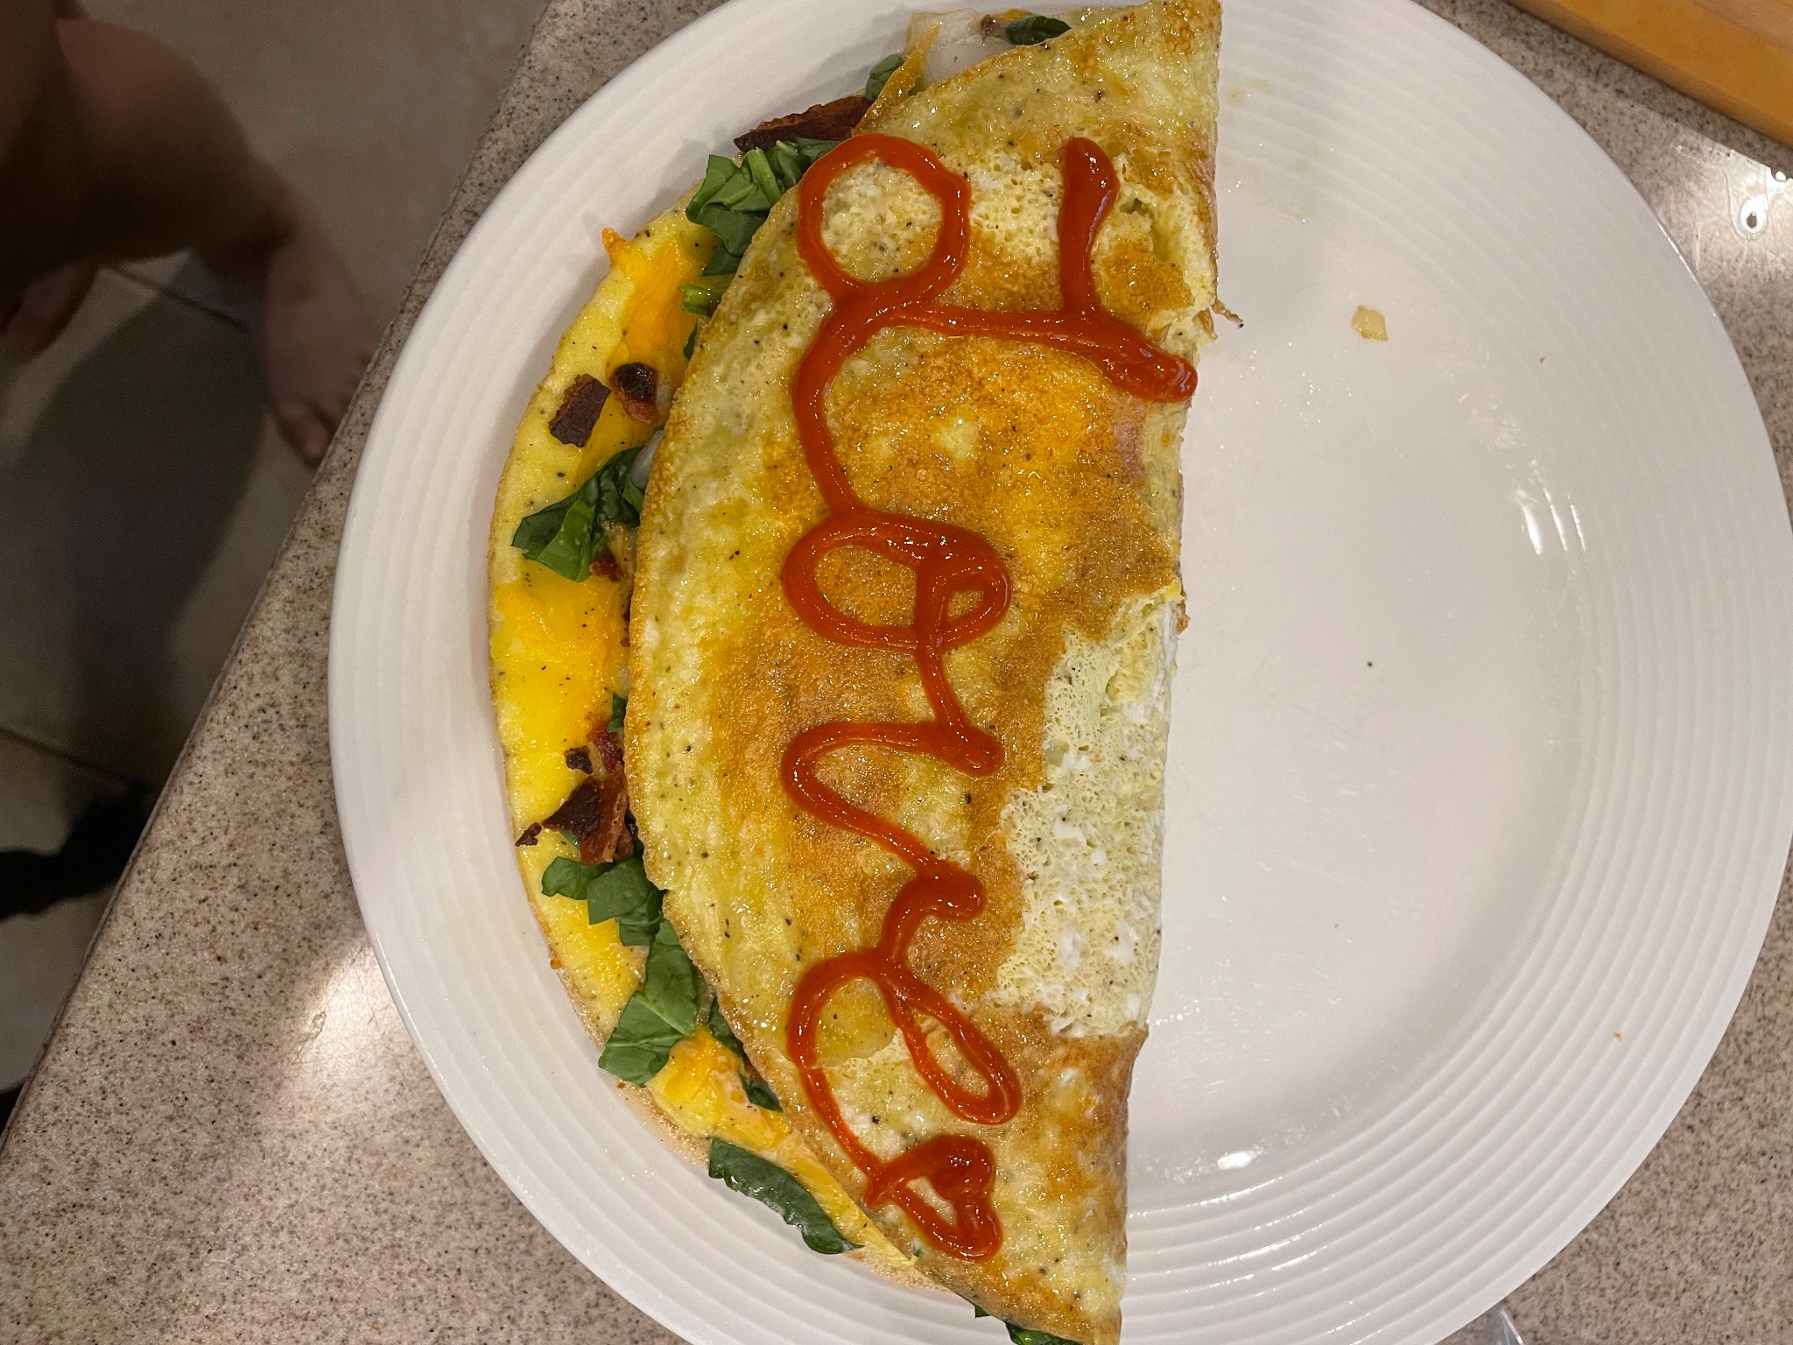
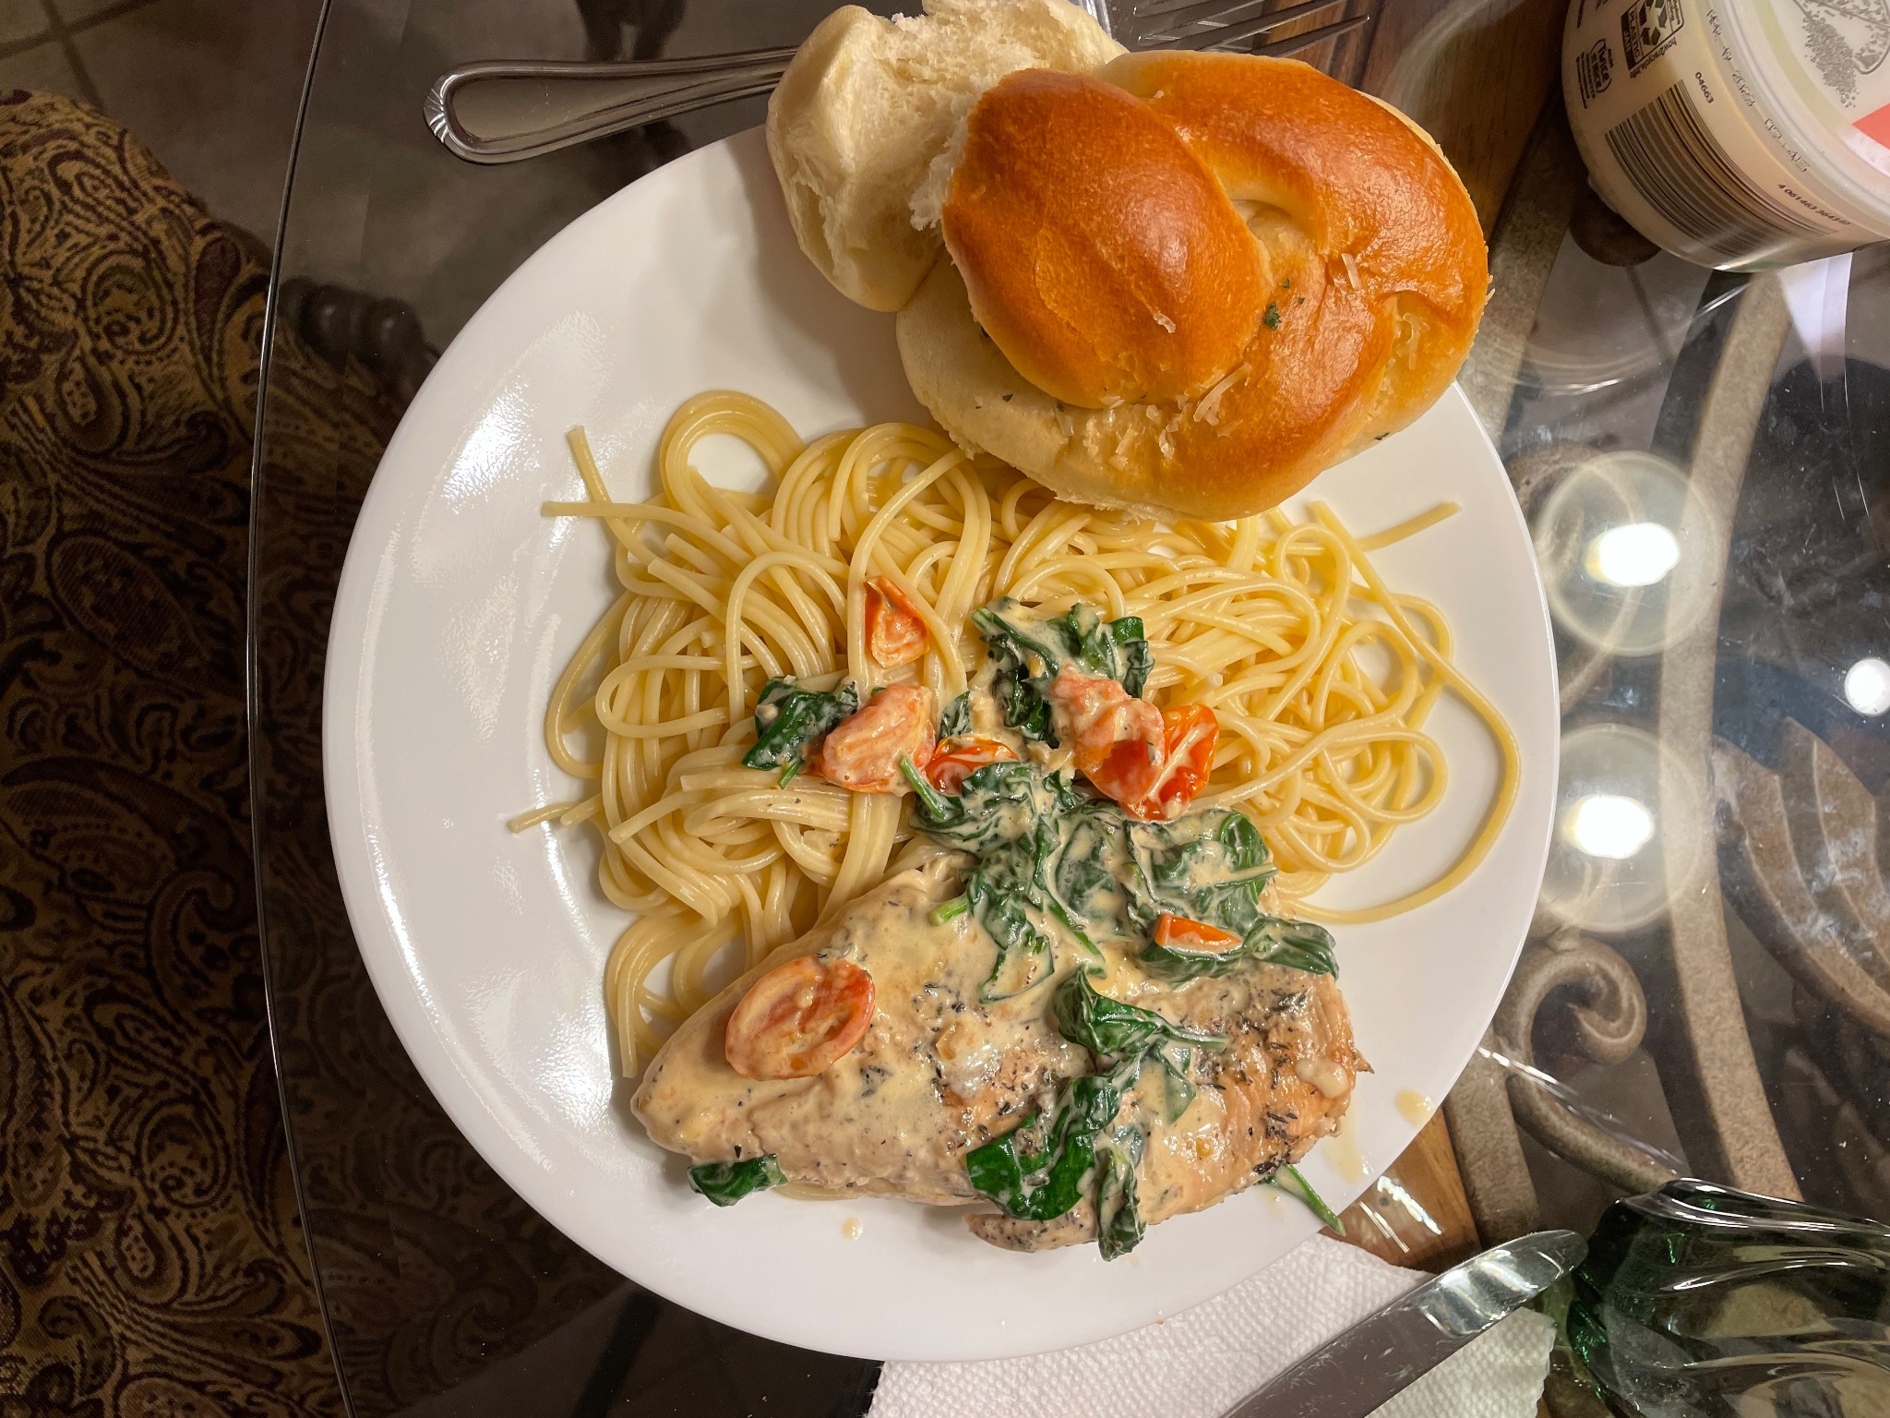
What is Tastey?

Slide 3
Project Scope
Read Recipes
Ingredients, Steps, Stories, Photos
Manage Recipes
Add, Load, Delete, and Search for Recipes
Accessibility
Day and Night Mode, Adjust Dietary Restrictions, Manage Account

Slide 4
Vision for Tastey
Easily accessible
Anyone from the age of 12 to 112 should be able to use this software
Inclusive for even the pickiest of eaters
Accounts for allergies, diets, and dislikes
Takes the math out of cooking
Select your serving size and relax
Indecisive? No worries!
Search for recipes based on even the vaguest of keywords

Slide 5
Cost Estimation

Slide 6
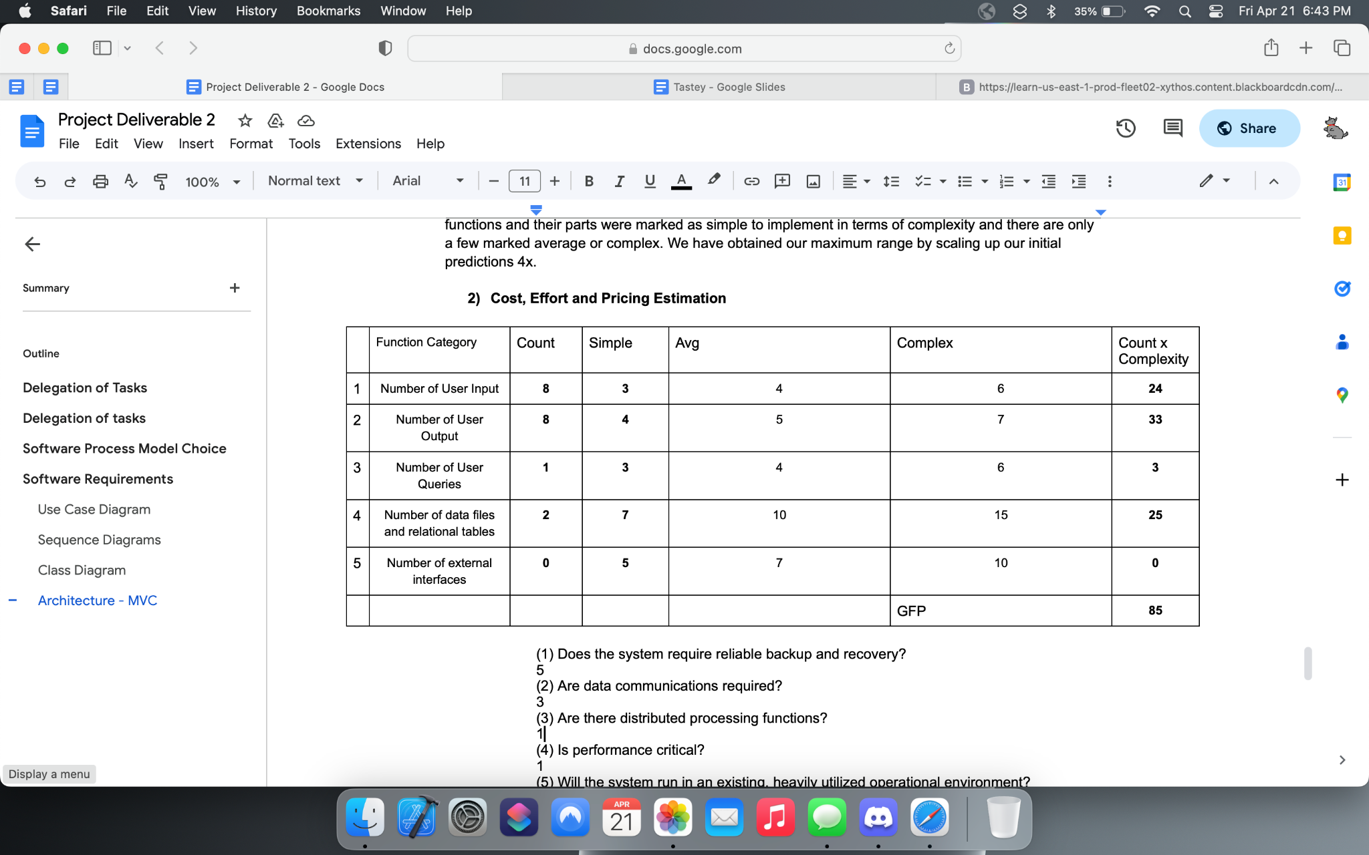
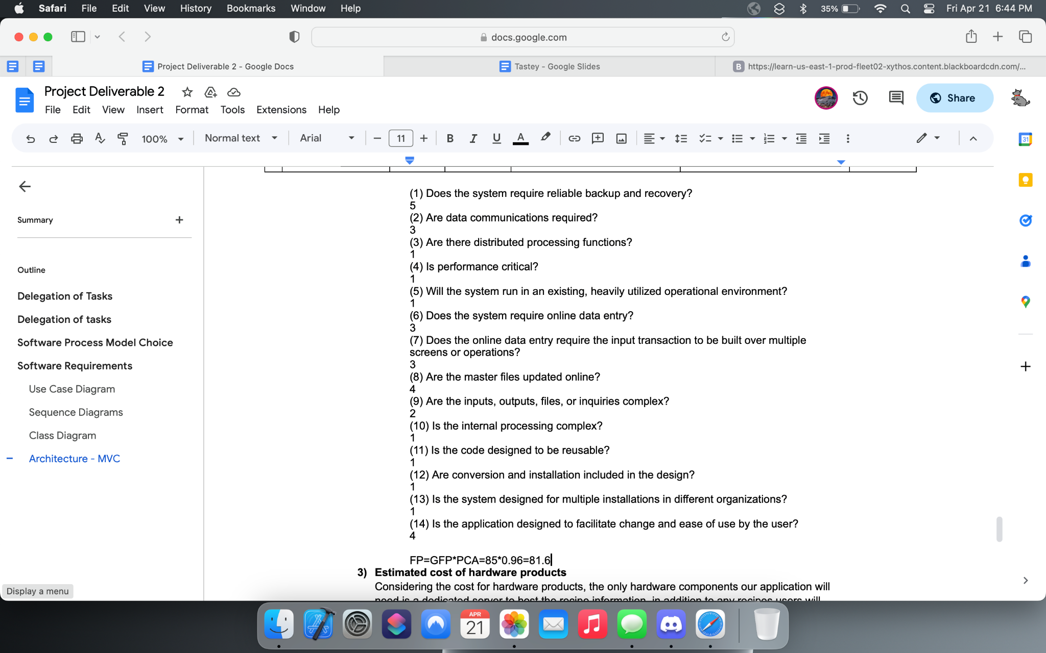
FP Method
FP = 81.6

Slide 7
Cost of Hardware
Tastey is a simple application that will rely on users devices and servers Servers need not be accessed frequently or quickly
Estimated $150 monthly, $1,800 annually

Slide 8
Cost of Software
No paid software required to create our project
If ported to app stores, must pay application fee
Apple - $99 annually
Google - $25 flat rate

Slide 9
Cost of Personnel
This is a passion project, so a small team of 6 members
3 hours per day, 5 days per week, over 4 month period
$20 per hour, comes to $9,600

Slide 10
Project Timeline

Slide 11
4 Month Timeline
Planning and Defining Requirements
Create Diagrams
Acquire and Test Hardware
Week 2
Week 5 - 14
Week 16
Week 1
Week 3 and 4
Week 15
Decide on Architecture
Software Development
Test Software and Launch
Notes:
Week 1
Planning/Defining Requirements
Week 2
Decide on Architecture
Week 3 and 4
Create Diagrams
Week 5 through 14
Software development
Week 15
Acquire and test hardware
Week 16
Test software and launch

Slide 12
Requirements

Slide 13
Functional Requirements
Add and Delete Recipes
Search Existing Recipes
Edit recipes
Search Tastey’s servers for more recipes

Slide 14
Non- Functional Requirements
Reliability
The system must be incredibly reliable, this software must work for years to come
Maintainability
Servers must stay online, otherwise downloading recipes will become difficult
Availability
The software must be available constantly, hunger makes people impatient

Slide 15
Non- Functional Requirements
Security
We will not handle sensitive information, however still require login authentication
Localization
Recipes need to be translated, and ingredients changed depending on location
Usability
The software must be easily accessible, everyone needs to cook

Slide 16
Non- Functional Requirements
Performance
Will not pose an issue since our software is not demanding
Scalability
Allow for servers to be upgraded in order for more users and recipes
Portability
Relatively simple since we are connecting to our own server, not through third party
Compatibility
Everyone eats, so no matter the software or hardware we must work with it

Slide 17
Use Case Diagram

Slide 18
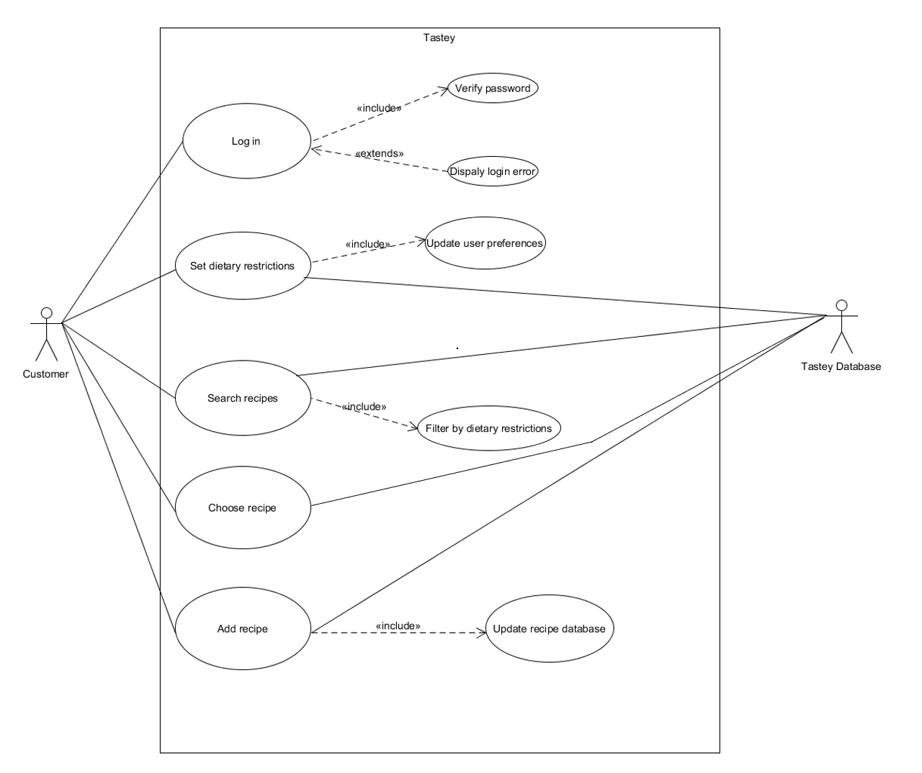
Use Case Diagram

Slide 19
Sequence Diagram

Slide 20
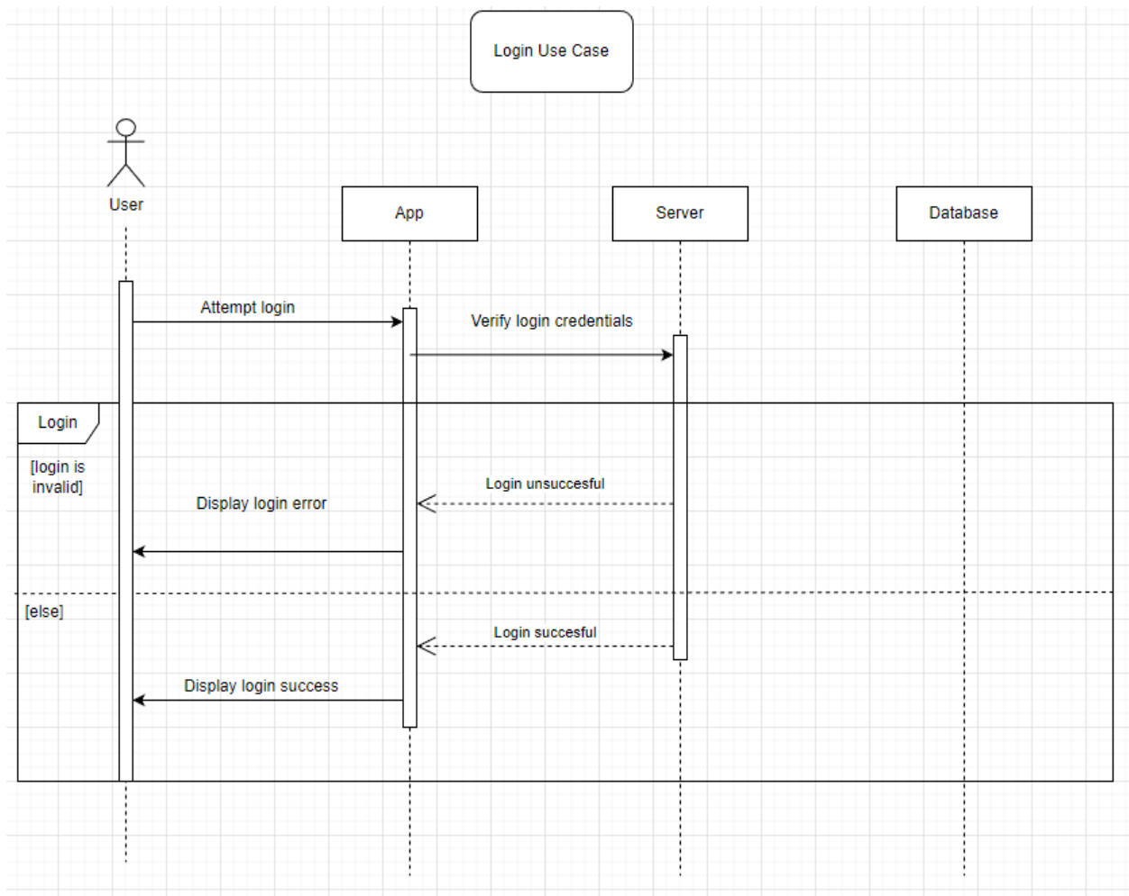
Login Diagram

Slide 21
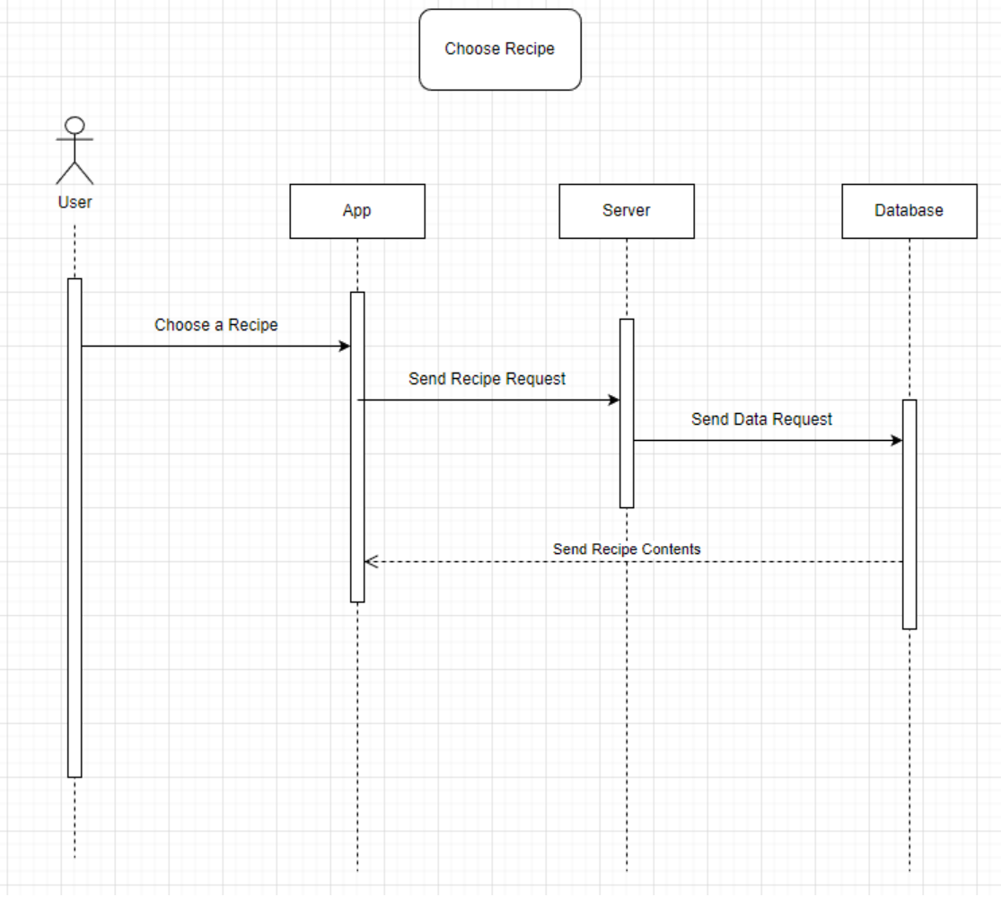
Choose Recipe Diagram

Slide 22
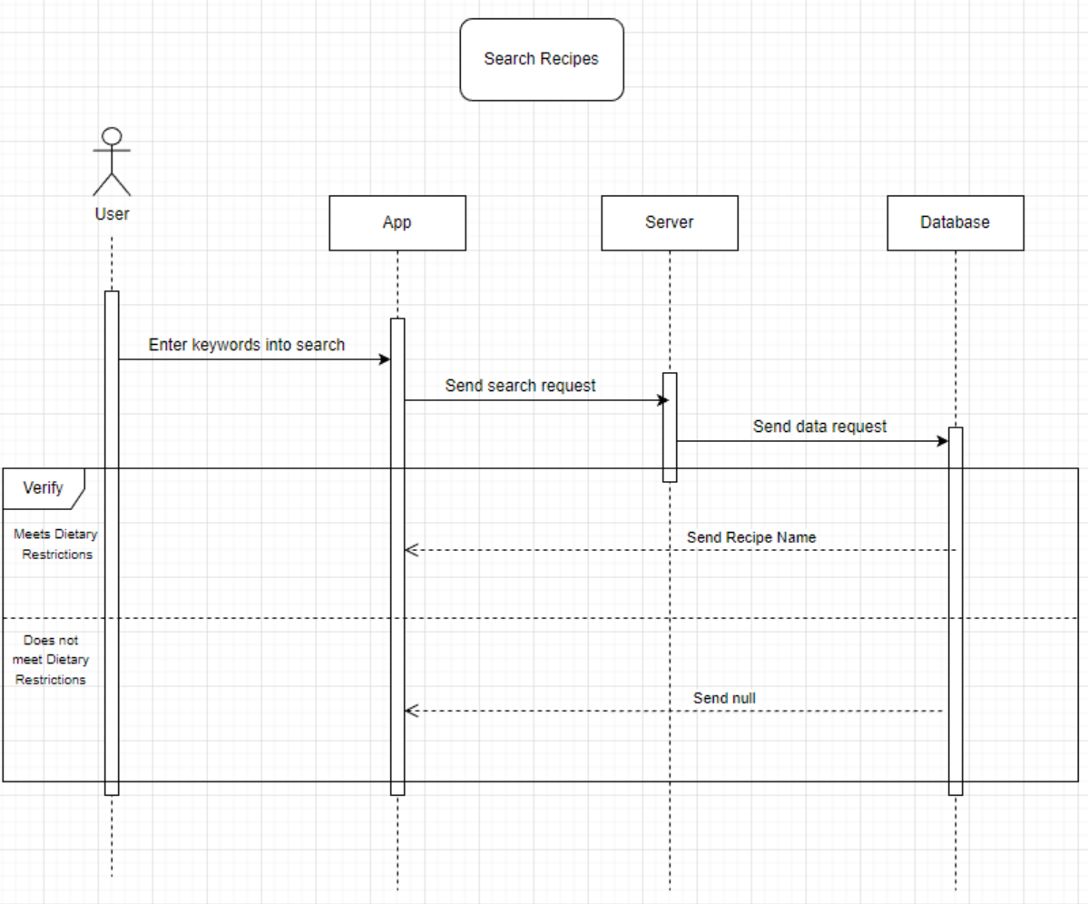
Search Recipe Diagram

Slide 23
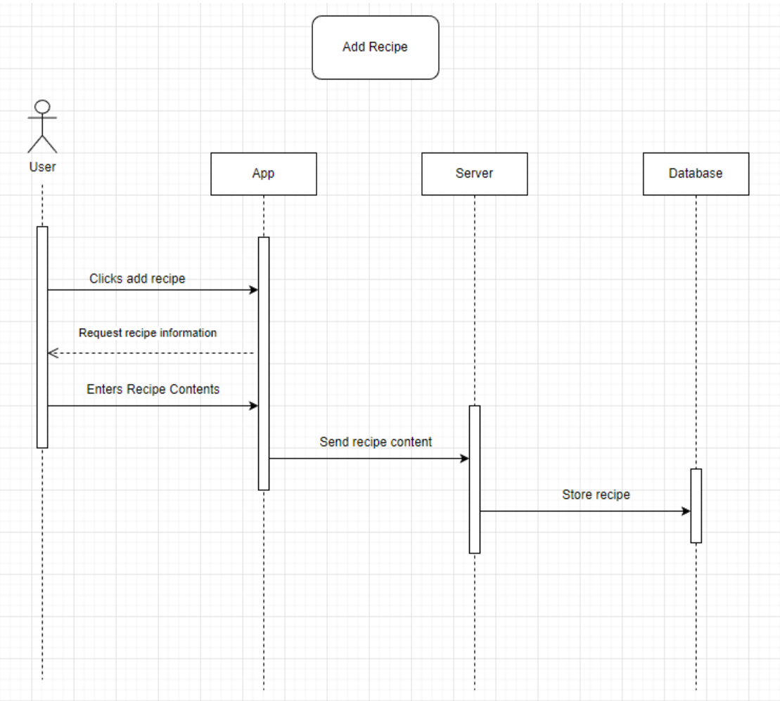
Add Recipe Diagram

Slide 24
Class Diagram

Slide 25
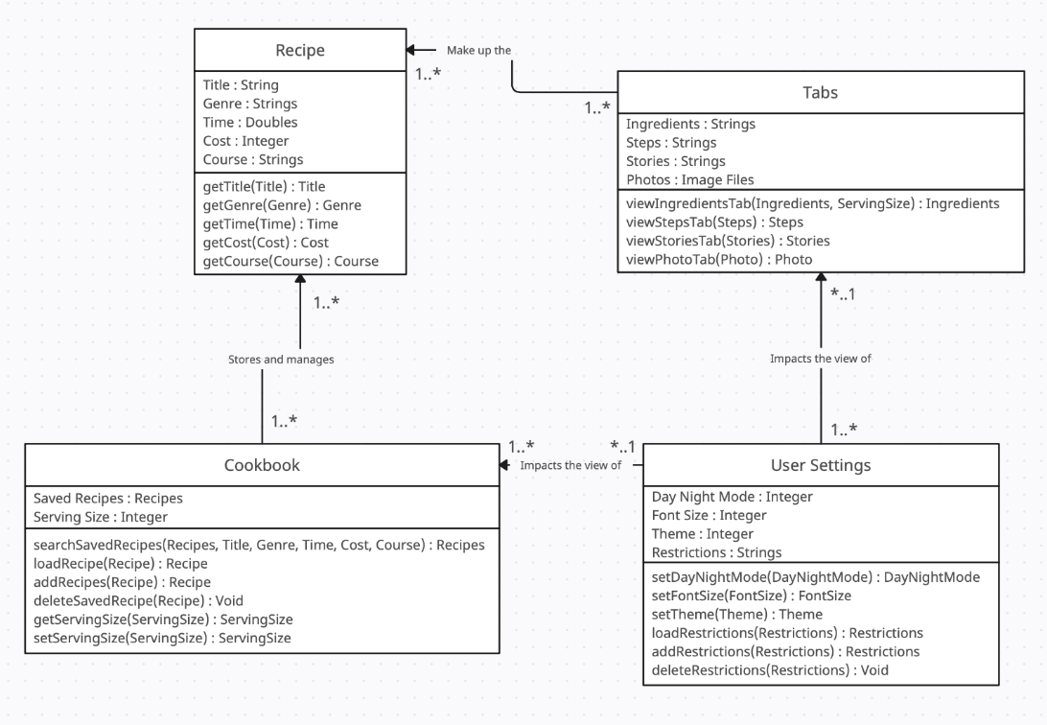
Tastey Class Diagram

Slide 26
Architectural Design

Slide 27
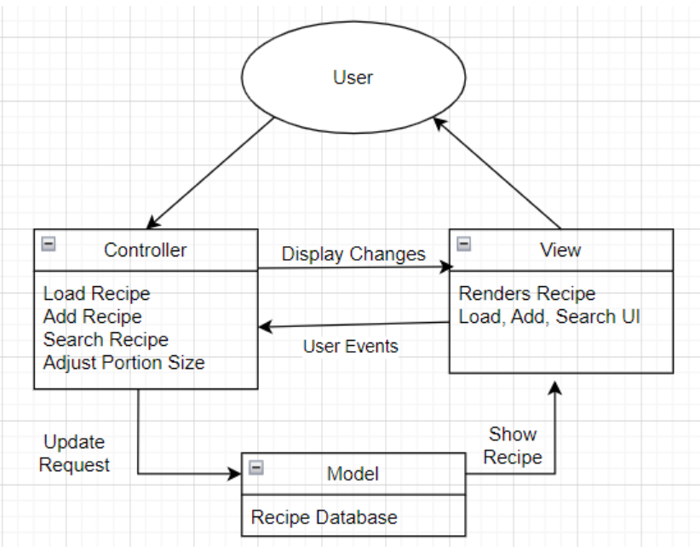
Model View Controller

Slide 28
Credit
Diagrams created using Creately and UMLet software Food photos provided by Cade Edwards and Charlotte Phanthavilay
Slideshow theme provided by Free Google Slides Templates

